Slide 1



Noida Institute of Engineering and Technology, Greater Noida
Basic Manufacturing Processes
Unit: 1
Digital Manufacturing Practices
AME0151
Prachee Srivastava
Assistant Professor
Mechanical Engineering Department
B. Tech
1st/2nd Sem

Slide 2
Contents
Course objective
Course outcome
Co Po mapping
Prerequisite and recap
Manufacturing methods
Classification of manufacturing methods
Introduction to Industry 4.0
Advance manufacturing methods
Video link
Daily quiz
Assignments
MCQS
References
Summary

Slide 3

Course Objective
Upon completion of this course:
1.To impart knowledge to students about the latest technological developments in manufacturing technology.
2.To make the students capable to identify and use primary machine tools for manufacturing of job/product.
3.To make the students understand constructional features, principle and coding/ programming of CNC machines.
4.To explain current and emerging 3D printing technologies in industries.
5.To impart fundamental knowledge of Automation and Robotics.
Prachee Srivastava
Unit-1

Slide 4







Course Outcome
Once the student has successfully completed this course, he/she will be able to:
Understand various manufacturing process which are applied in the industry.
CO1
Demonstrate the construction and working of conventional machine tools and computer controlled machine tools.
CO2
Understand the programming techniques of CNC machines and Robotic arms.
CO3
Use the different 3D printing techniques.
CO4
Prachee Srivastava
Unit-1

Slide 5
CO-PO Mapping
 | PO1 | PO2 | PO3 | PO4 | PO5 | PO6 | PO7 | PO8 | PO9 | PO10 | PO11 | PO12
CO1 | 3 | 1 | 1 | 2 | 2 | 2 | 1 | 1 | 3 | 2 | 1 | 2
CO2 | 3 | 1 | 1 | 1 | 1 | 2 | 1 | 1 | 2 | 1 | 1 | 3
CO3 | 3 | 1 | 1 | 1 | 2 | 2 | 1 | 1 | 2 | 1 | 1 | 2
CO4 | 3 | 1 | 1 | 2 | 1 | 2 | 1 | 1 | 2 | 1 | 1 | 2

Slide 6
Prerequisite and Recap
Prerequisite
Recap
Students should be 10+2 pass with science.
This is the first unit of syllabus.
Student should have a general knowledge about tools and material properties.
Student should be aware with the basic manufacturing processes going in the surroundings like welding and blacksmithy.

Slide 7
Topic objective, Prerequisite and Recap
Topic Objective
Manufacturing methods
Prerequisites
General idea about tools and materials
Recap
First unit of the syllabus

Slide 8
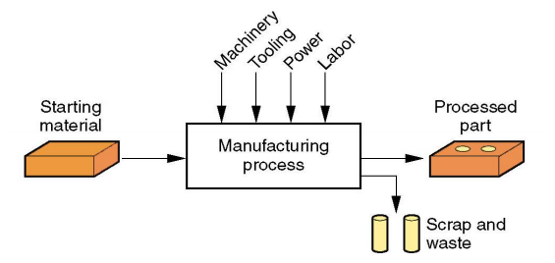
Introduction to Manufacturing Methods(CO2)
Manufacturing is the conversion of raw materials into useful product by the application of machines and tools.
Technologically: Physical and chemical processes to alter size, shape and properties of material suitable for service use

Slide 9
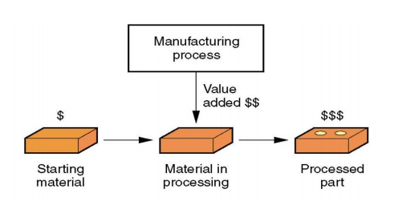
Manufacturing Methods(CO2)
Economically: (value addition) A step to convert raw material into useful product of high value.

Slide 10
INTRODUCTION TO WORKSHOP LAYOUT
Workshop is a place where raw material gets converted into useful product.
Workshop layout is the optimum arrangement of different machines, work benches and shops in a work shop.
Bad layout means that the product travels and is handled too much during manufacture, and that people have to walk about too much.
With bad layout, the product goes back and forward between processes. This uses more labour and more trucks, leads to delays at machines and makes work in progress difficult to find.
Space is wasted and the workers get in each other's way.

Slide 11
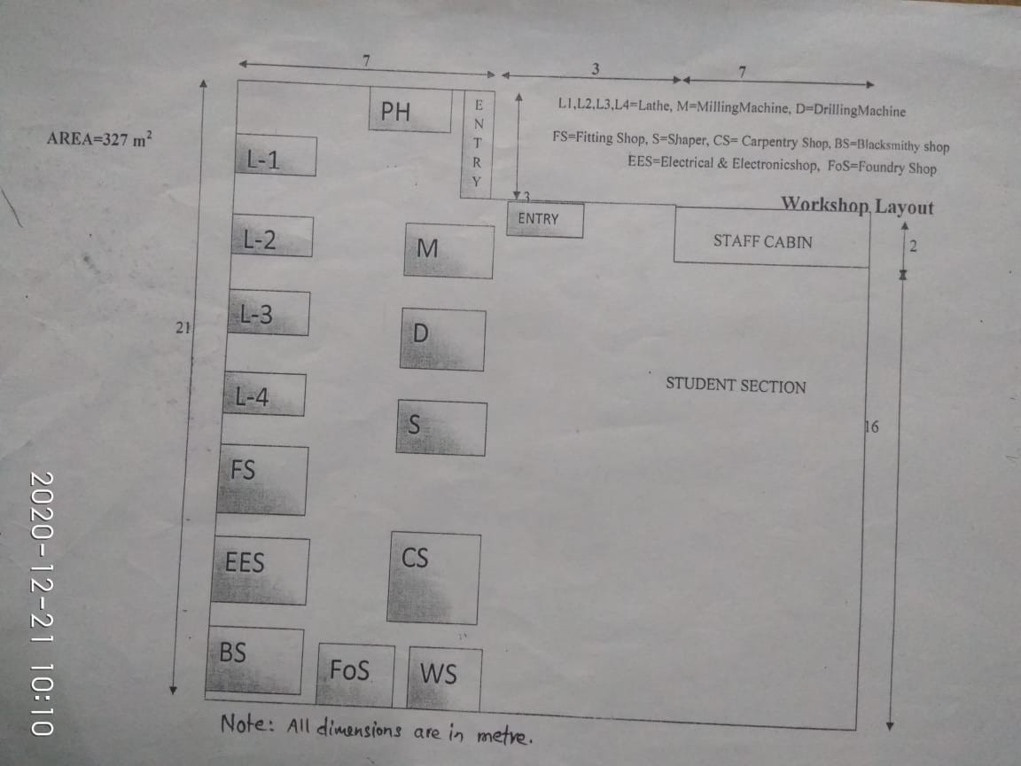
INTRODUCTION TO WORKSHOP LAYOUT

Slide 12
Introduction to Industry 4.0 (CO1)
Manufacturing has undergone several eras of change-
First industrial revolution (steam power & mechanical production),
Second IR. (use of electricity and mass production)
Third era defined by increased automation of manufacturing processes due to the use of information technology (IT).
Fourth era of change – Industry 4.0 – is driven by trends on connectivity, service orientation, advanced materials and processing technology, and collaborative advanced manufacturing networks; networks of advanced manufacturing devices controlled by computers combining them into a physical – digital environment.

Slide 13
Understanding Industry 4.0 (CO1)
Industry 4.0 creates new design principles along which the industry can organize itself, these include:
Increased interoperability between manufacturing networks through increased connectivity, virtualization of manufacturing processes by linking sensor data (from monitoring physical processes) with virtual plant and simulation models.
New materials and processing technologies are making manufacturing more efficient while increasing the ability to customize allowing the industry to quickly become more agile, flexible, and decrease scale requirements

Slide 14
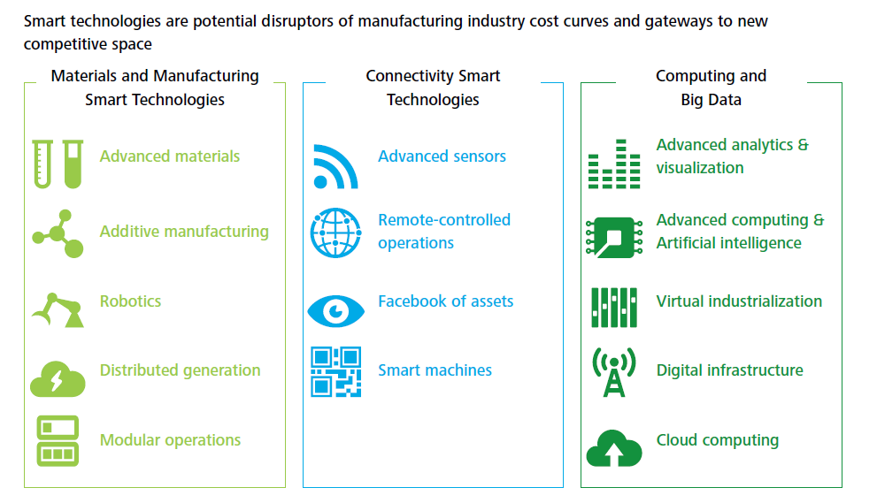
Understanding Industry 4.0…Contd

Slide 15
Industry 4.0 opportunities (CO1)
Integrated networks for product design: national automotive manufacturer and a government agency used crowdsourcing to design customized vehicles with minimal investment in a reasonable timeframe.
Advanced materials permit new product designs: a global manufacturer designed a continuous, hybridized additive manufacturing process embedding functional elements into in-mold labeling material.
High Performance Computing and Simulation: using supercomputing to accelerate the product design process, the company was able to run simulations and test new ideas reducing time-to-market from 5 years to 2 weeks.

Slide 16
Topic objective, Prerequisite and Recap
Topic Objective
Engineering Materials
Prerequisites
Definition of material
Recap
Manufacturing methods

Slide 17
Engineering Materials
The substances which are useful in the field of engineering are called Engineering materials. A particular material is selected is on the basis of following considerations.
1.Properties of material
Mechanical properties - strength, ductility, toughness, hardness, strength to weight ratio etc.
Physical properties - density, specific heat, thermal expansion, conductivity , melting point etc.
Chemical properties - oxidation , corrosion, flammability, toxicity etc. Manufacturing properties - formed, casting, machined, welding

Slide 18
Engineering Materials
2. Cost of material
3. Availability of material (desired shape and size and quantity) & reliability of supply.
Dimensional stability of material wear, corrosion etc., shorten life.
Appearance of material Color, Surface texture etc.

Slide 19
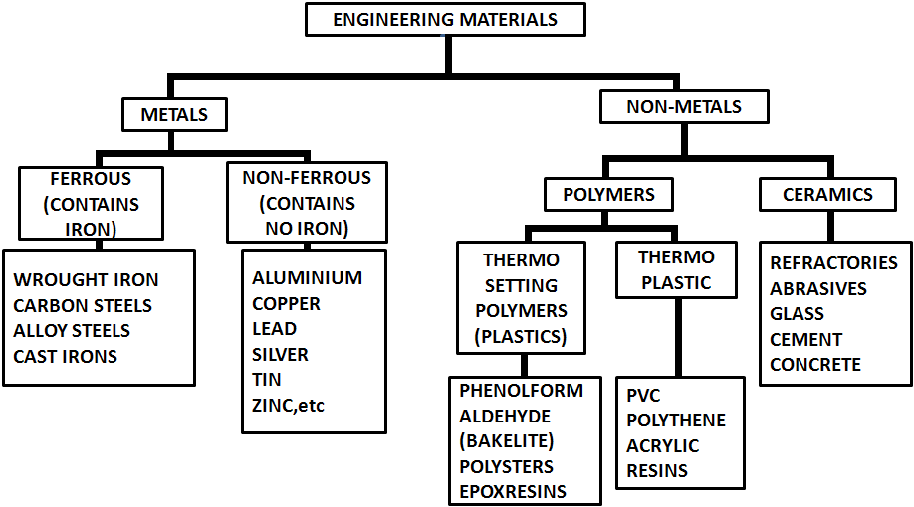
Classification Of Engineering Materials

Slide 20
Classification Of Engineering Materials
Polymer, any of a class of natural or synthetic substances composed of very large molecules, called macromolecules, that are multiples of simpler chemical units called monomers. Polymers make up many of the materials in living organisms, including, for example, proteins, cellulose, and nucleic acids
A polymer is a substance or material consisting of very large molecules, or macromolecules, composed of many repeating subunits. Due to their broad spectrum of properties, both synthetic and natural polymers play essential and ubiquitous roles in everyday life.
Ceramics Ceramics are solid compounds that may consist of metallic or nonmetallic elements. The primary classifications of ceramics include glasses, cements, clay products, refractories, and abrasives.
Ceramics generally have excellent corrosion and wear resistance, high melting temperature, high stiffness, and low electrical and thermal conductivity. Ceramics are also very brittle materials

Slide 21
Types of plain carbon steel
(i) 0.05-0.15 %C - Dead mild steel
(ii)0.15-0.30%C - Low Carbon Steel
(iii)0.30-0.80%C - Medium Carbon Steel
(iv) 0.80-1.5% C - High Carbon Steel

Slide 22
ALLOY STEEL
Alloy steel is a type of steel alloyed with several elements such as molybdenum, manganese, nickel, chromium, vanadium, silicon, and boron.
These alloying elements are added to increase strength, hardness, wear resistance, and toughness.
High-speed steel (HSS or HS) is a subset of tool steels, commonly used as cutting tool material.

Slide 23
High speed steel
It is used for cutting tools for machine .
Tungsten H.S.S.
18 % W (it improves Hardness)
4 % Cr (it improves corrosion resistance)
1% V (it improves toughness at high temperature)

Slide 24
Cast iron
Cast iron 2-4.5 % Carbon
It is a Brittle material
High compressive strength
High hardness.
Used for supporting member of the machines, because it can resist shock and vibration during machining.

Slide 25
Topic objective, Prerequisite and Recap
Topic Objective
Mechanical properties of metal
Prerequisites
Properties of metal
Recap
Engineering material

Slide 26
Mechanical Properties
The characteristics of material that describe the behavior under the action of external loads are referred as its mechanical properties. The common mechanical properties are as follows
STRENGTH :
It is defined as the ability of a material to resist loads without failure.
It is usually expressed or measured in terms of maximum load per unit area (i.e maximum stress or ultimate strength) that a material can withstand failure and it varies according to the type of loading

Slide 27
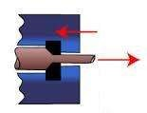
Mechanical Properties
ELASTICITY :
The ability of a material to deform under load and return to its original shape when the load is removed is called elasticity.
PLASTICTY :
The ability of a material to deform under load and retain its new shape when the load is removed is called plasticity.
DUCTILITY :
It is the ability of a material to be deformed plastically without rupture under tensile load. Due to this property material can drawn out into fine wire without fracture.
Ductility

Slide 28

Mechanical Properties
MALLEABILITY :
It is the ability of a material to be deformed plastically without rupture under compressive load. Due to this property metals are hammered and rolled into thin sheets
TOUGHNESS :
It is defined as the ability of the material to absorb energy up to fracture during the plastic deformation. Toughness of a metal offers the resistance to breaking when force is applied.
BRITTLENESS :
It is the property of sudden fracture without any visible permanent deformation.
Malleability

Slide 29
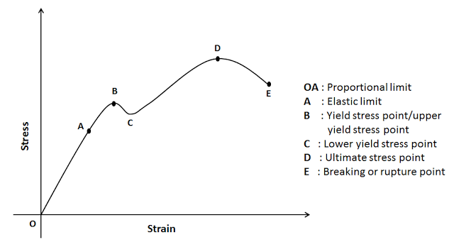
Mechanical Properties
HARDNESS
It is defined as the ability of a material to resist scratching or indentation by another hard body. Hardness is a surface property.

Slide 30
Topic objective, Prerequisite and Recap
Topic Objective
Classification of Manufacturing processes
Prerequisites
Manufacturing process introduction
Recap
Mechanical properties of metals

Slide 31
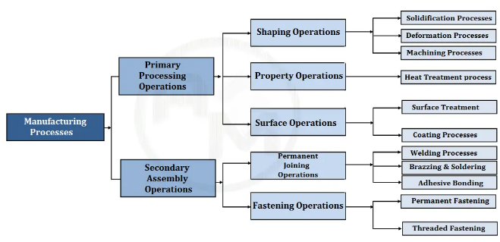
Classification of Manufacturing processes(CO2)

Slide 32
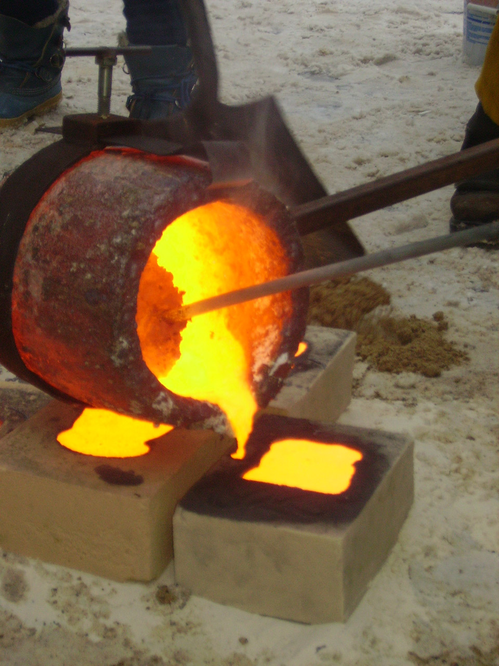
Shaping Process(CO2)
Shaping operations alter the geometry of the starting work material by various methods. Common shaping processes include casting, forging and machining.
Most shape processing operations apply heat, mechanical force or a combination of these to effect a change in geometry of the work material.
Fig1. casting process

Slide 33
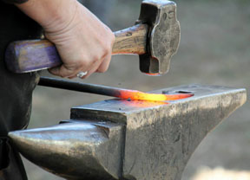
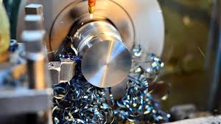
Shaping Process(CO2)
Fig . Hand forging Fig . Machining

Slide 34
Solidification Process (CO2)
In solidification processes, the raw material is heated to liquid state and then it is poured to a mould cavity, after solidification required product is formed.
Nearly all materials can be processed this way if it has relatively low melting point, such as polymers, metals, and glass ceramics.
Casting is the name used for metals and molding is the common term used for plastic.

Slide 35
Solidification Process(CO2)
Casting
Casting is the process of producing metal parts by pouring molten metal into the mould cavity of the required shape and allowing the metal to solidify. The solidified metal piece is called as "casting".
Steps in sand casting:
Pour molten metal into sand mold
Allow metal to solidify
Break up the mold to remove casting
Clean and inspect casting

Slide 36
Solidification Process(CO2)
Advantages of casting process
Any intricate shape may be internal or external can be made.
It is practically possible to cast any material.
Tools required for casting processes are generally inexpensive.
It is practically possible to make casting of any size, even up to 200 tons.
Disadvantages: Some finishing required; relatively coarse surface finish; Wide tolerances

Slide 37
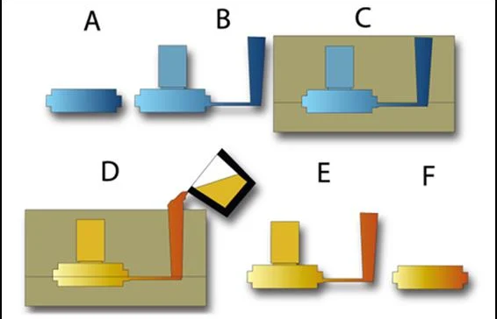
Casting Process(CO2)
Fig: step by step casting process

Slide 38
Casting Process(C02)
Casting
Producing the Pattern – Desired product
Producing the Pattern – Gates and risers: The gating system
Creating the mould cavity
Pouring the liquid metal into the mold
Removing the solidified metal
Final operations

Slide 39
Deformation Process(CO2)
Deformation processes, in which the starting material is a ductile solid (commonly metal) that is deformed to shape the part.
The size and shape of a part is obtained by plastic deformation under the action of large action forces.
Material wastage is zero here.
To increase ductility , the work material is often heated before forming to a temperature below the melting point.
Performed as cold and hot working operations.

Slide 40
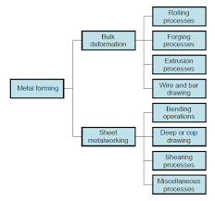
Deformation Process(CO2)
Bulk deformation process
Rolling
Forging
Extrusion
Wire drawing
Sheet metal process
Bending operations
Deep drawing
Shearing process

Slide 41
Deformation Process (CO2)
Advantages of metal forming
Higher productivity – Rolling & Forging units fabricate hundreds of tones of end product.
High-Standard Quality Products – Required physical, Mechanical & structure can be achieved
High strength, Corrosion & Wear resistance
High dimensional accuracy & Surface finish
Extra thin Foil, Wire, Sheet steel can be made. Other processes can’t able to produce
Minimum waste of metal – No chip formation

Slide 42
Machining Process(CO3)
The metal removal process is known as machining process.
Machining is a manufacturing process in which a sharp cutting tool is used to cut away material to leave the desired part shape.
Machining is most frequently applied to shape metals.
Machining operations form chip; as the chip is removed, a new surface is exposed.

Slide 43
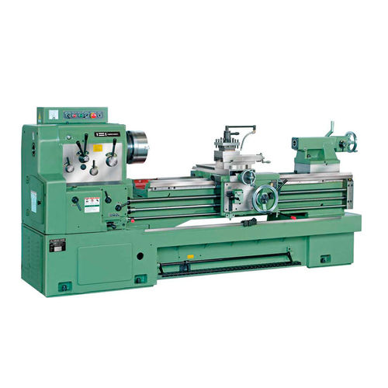
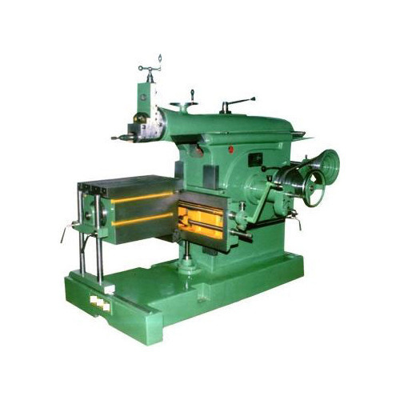
Machine tools used (CO3)
Fig: Lathe machine Fig: Shaper machine

Slide 44
Joining Process (CO4)
Parts produced by any of the manufacturing process can be made into larger, more complex bodies via joining process.
Joining includes welding, brazing, soldering, adhesive bonding of materials.
They produce permanent joint between the parts to be assembled.
They cannot be separated easily by application of forces.
They are mainly used to assemble many parts to make a system.

Slide 45
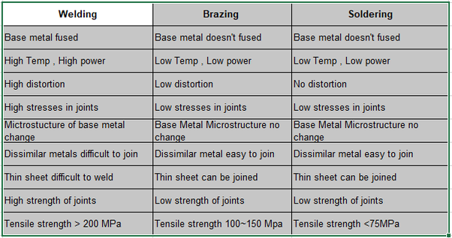
Joining Process (CO4)

Slide 46
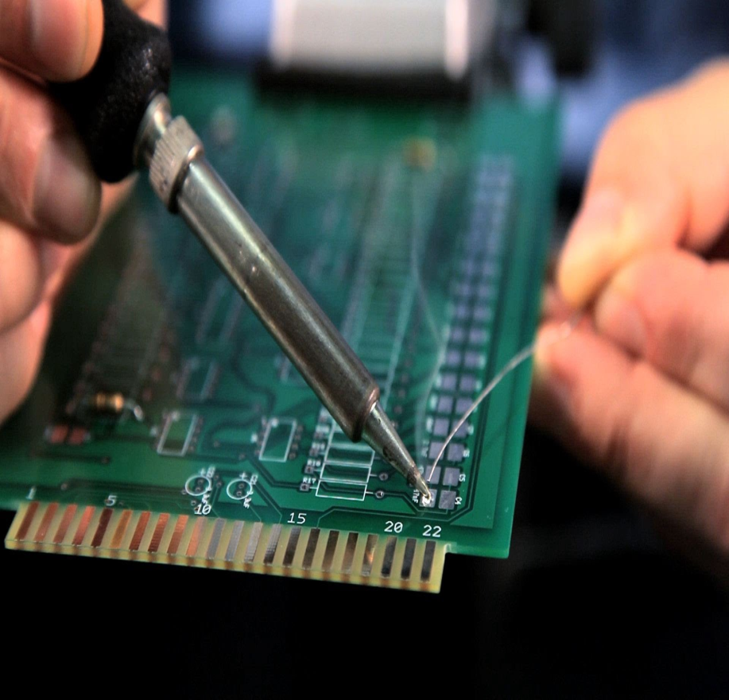

Joining Process (CO4)
Fig: Soldering Fig: Electric arc welding

Slide 47
Topic objective, prerequisite ,recap
Topic Objective
Advance manufacturing methods
Prerequisites
Knowledge of basic manufacturing processes
Recap
Introduction to manufacturing process

Slide 48
Advanced manufacturing Process(CO1)
Moving into the domain of manufacturing methods, lets see formal definition of advanced manufacturing.
It is defined as “The utilisation of enabling technologies, incorporating design and business process innovation to deliver high value added process and products in ways that are novel and competitive.”
Advanced manufacturing is the use of innovative technologies and methodologies for improved competitiveness in the manufacturing sectors.

Slide 49
Advanced manufacturing Process(C01)
Need for advanced manufacturing process:
Limitations in conventional methods.
Rapid improvement in material properties.
High tolerance requirements.
Product requirements.
High production with low cost.

Slide 50
Advanced manufacturing Process(C01)
Advanced metal casting processes-
Shell molding process
Permanent mold casting
Centrifugal casting
Pressure die casting
Advanced machining processes-
Laser beam machining
Electron beam machining
Abrasive jet machining
Electric discgarge machining
Advanced welding processes-
Plasma beam welding
Laser beam welding
Electron beam welding

Slide 51
Faculty Video Links, Youtube & NPTEL Video Links and Online Courses Details
Self Made Video Link:
YouTube/other Video Links
Sand casting animation video- https://youtu.be/uMyKr6hZD3I
making a bottle opener through forging- https://youtu.be/K-Zg1-fR9kU

Slide 52
Daily Quiz
What is metal removal process?
Define manufacturing process
Classify manufacturing process.
What do you mean by solidification process?
Write any four deformation process.

Slide 53
Weekly Assignment
What is the need of advance manufacturing process?
Name any five advance manufacturing process.
Differentiate between welding soldering and brazing.
What are the applications of soldering?
Differentiate between bulk deformation and sheet deformation.

Slide 54
MCQs
Strength of the welded joint is_____ than soldered joint.
Less b) more
2. Welding process create which type of joints?
Temporary b) Permanent c) Both
Which of the following is deformation process.
Turning b) forging c) casting
________ materials can be easily deformed.
Ductile b) brittle
5. Which of the following is advance manufacturing methods?
a) Plasma arc welding b) brazing c) deep drawing

Slide 55
Expected Questions for University Exam
Define manufacturing process with its classification.
Define welding process. Give example.
Explain sheet metal process.
What are the properties of material required for metal forming process?
Explain machining process.
* This is a practical subject, so no university examination is conducted. Only internal and external viva exam is conducted.

Slide 56
References
Hajra Choudhury S.K., Hajra Choudhury A.K. and Nirjhar Roy S.K., “Elements of Workshop Technology”, Vol. I 2008 and Vol. II 2010, Media promoters and publishers private limited, Mumbai.
Kalpakjian S. And Steven S. Schmid, “Manufacturing Engineering and Technology”, 4th edition, Pearson Education India Edition, 2002.
Gowri P. Hariharan and A. Suresh Babu,”Manufacturing Technology – I” Pearson Education, 2008.
Roy A. Lindberg, “Processes and Materials of Manufacture”, 4th edition, Prentice Hall India, 1998.
Rao P.N., “Manufacturing Technology”, Vol. I and Vol. II, Tata McGrawHill House, 2017.

Slide 57
Summary
Manufacturing is the process of converting raw material into finished product.
Manufacturing process is categorized into primary processing operations and secondary assembly operations.
Casting : Casting is the process of producing metal parts by pouring molten metal into the mould cavity of the required shape.
Deformation process: The size and shape of a part is obtained by plastic deformation under the action of large action forces.
Machining process: Machining is a metal removal process.
Welding: The processes of joining two or more similar or dissimilar metals with the help of heat is known as welding. Pressure may or may not be applied.
Limitations in the conventional methods led to the emergence of advance manufacturing methods.

Slide 58
Thanks

